Slide 1







Supermart Grocery
Sales-Retail Analytics
Dataset
By- Kumari Neha

Slide 2



Introduction
This project focuses on analyzing grocery sales data from a supermart in Tamil Nadu, India.
The dataset includes various features like product category, city, region, sales, discounts, and profit.
By exploring and analyzing this data, we aim to uncover sales patterns and build a predictive model for better business insights.

Slide 3



Objective
The primary objective is to:
Understand sales trends and key factors influencing sales through exploratory data analysis (EDA).
Develop a machine learning model to accurately predict sales, helping in strategic decision-making and improving business performance.

Slide 4
Scope
Data Preprocessing: Handling missing values, encoding categorical data, and feature scaling.
Exploratory Data Analysis (EDA): Visualizing sales trends and identifying patterns.
Model Building: Using linear regression to predict sales.
Model Evaluation: Assessing the model's performance using metrics like Mean Squared Error (MSE) and R-squared.

Slide 5
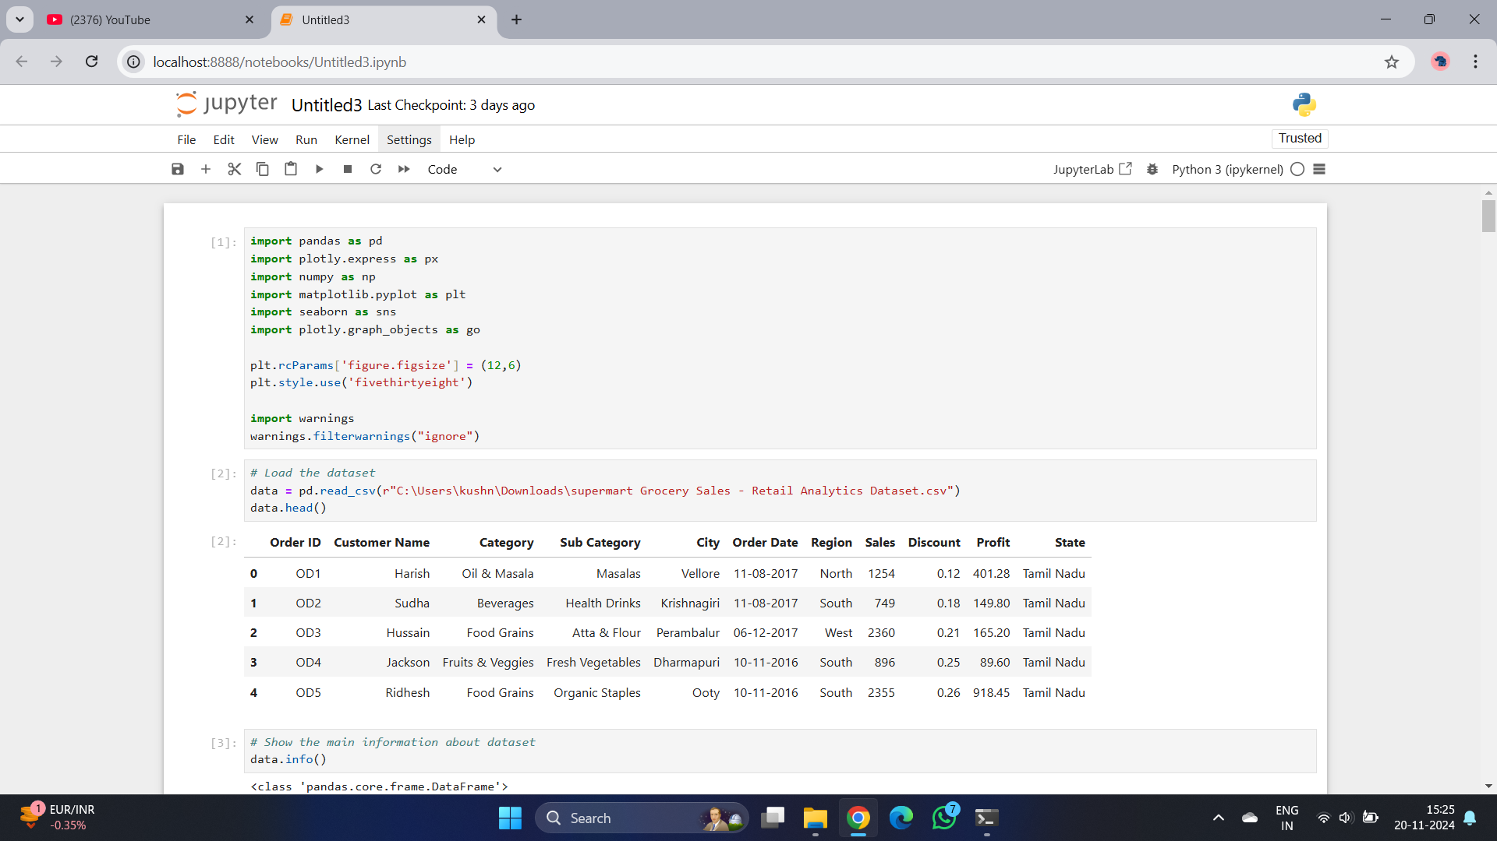
Import Libraries
Import the necessary libraries:

Slide 6
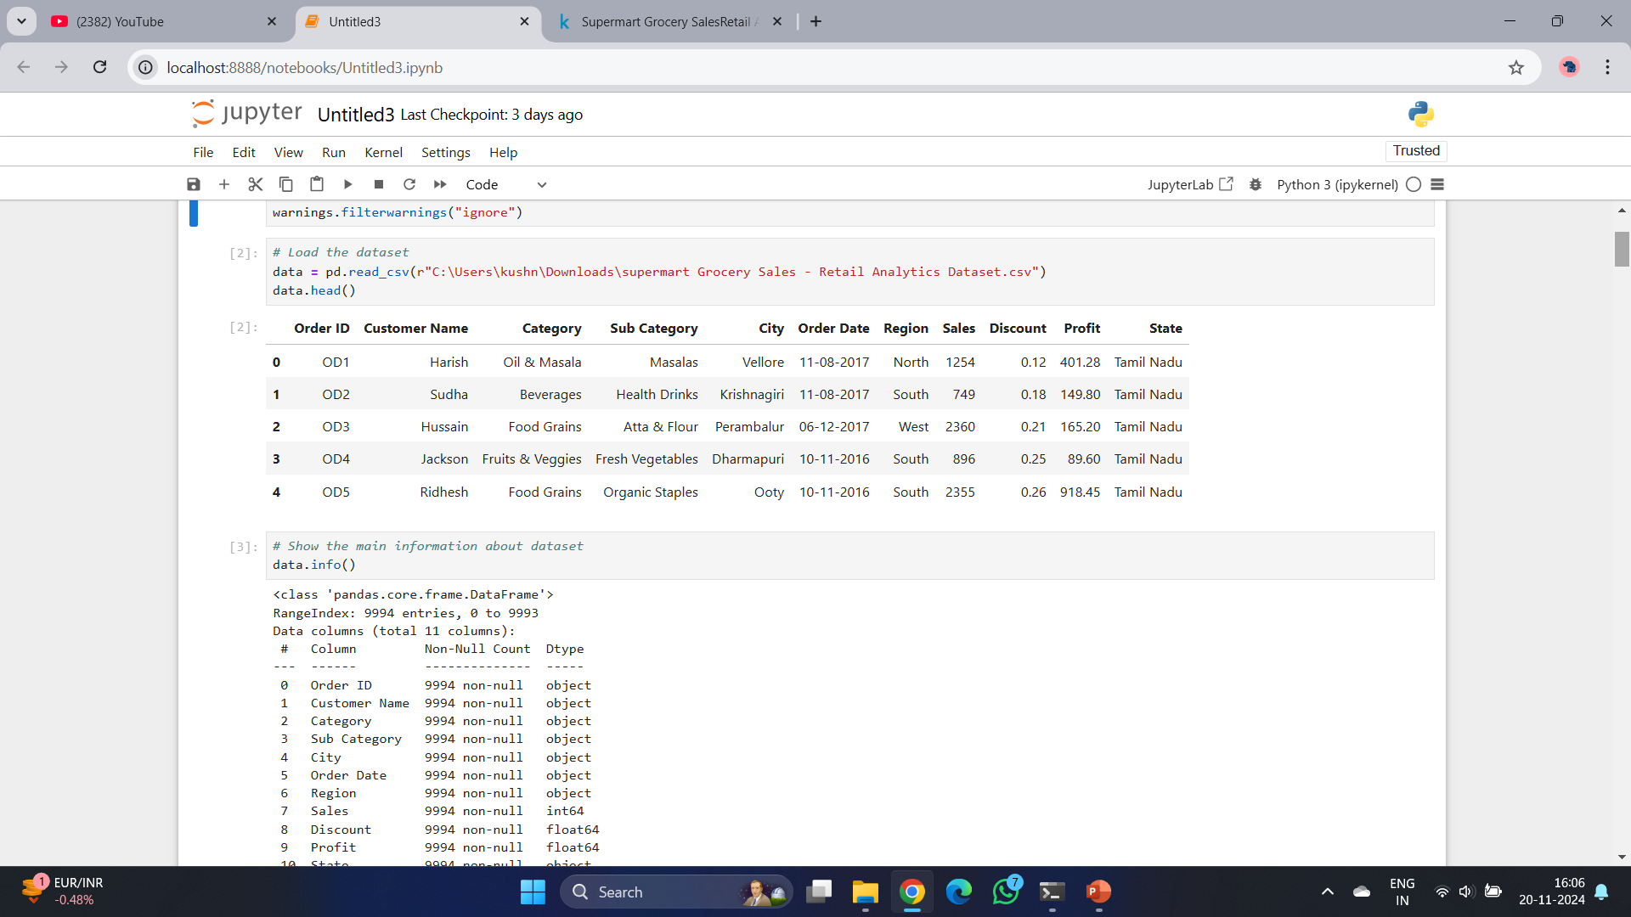
Load the dataset

Slide 7
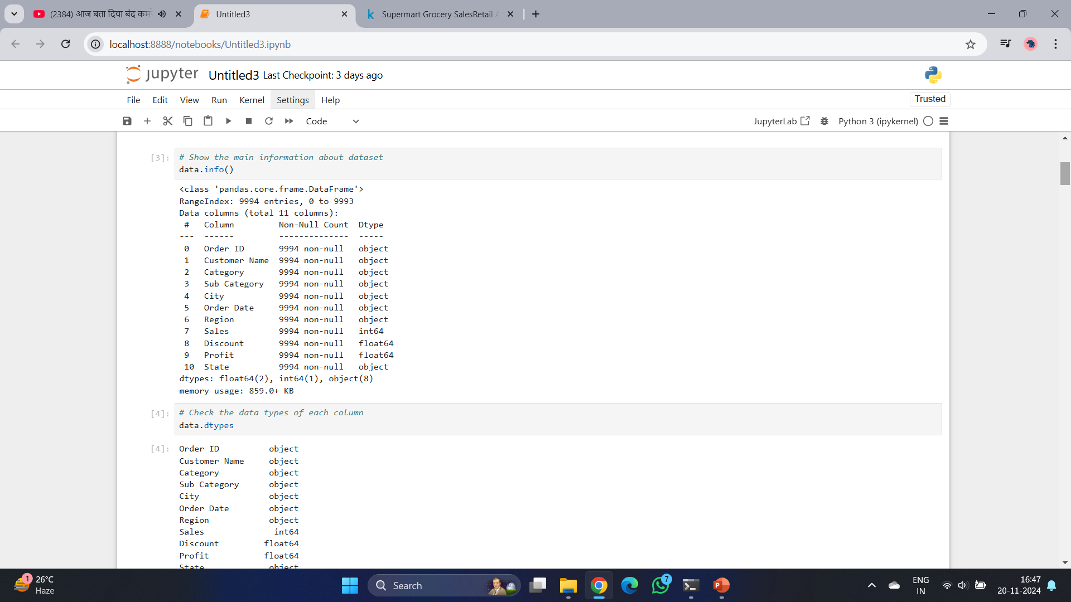
Understand the data

Slide 8
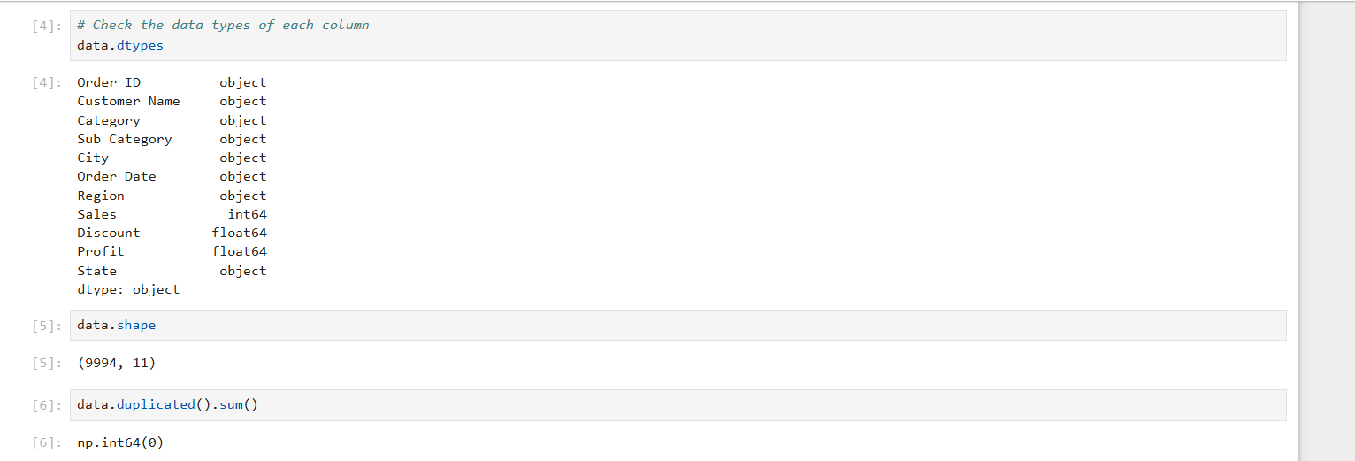

Slide 9
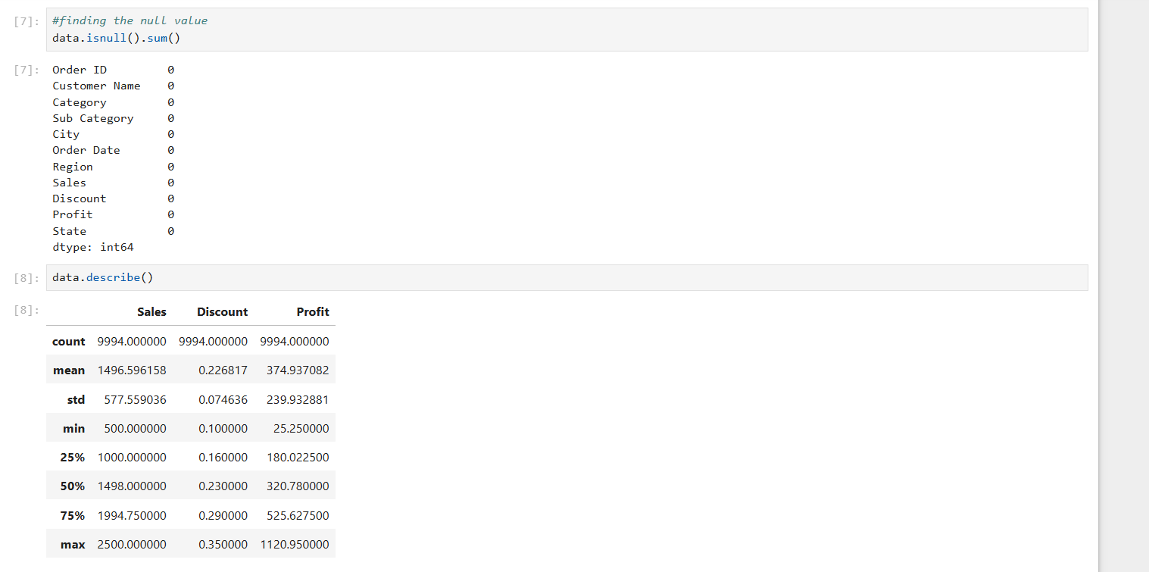

Slide 10
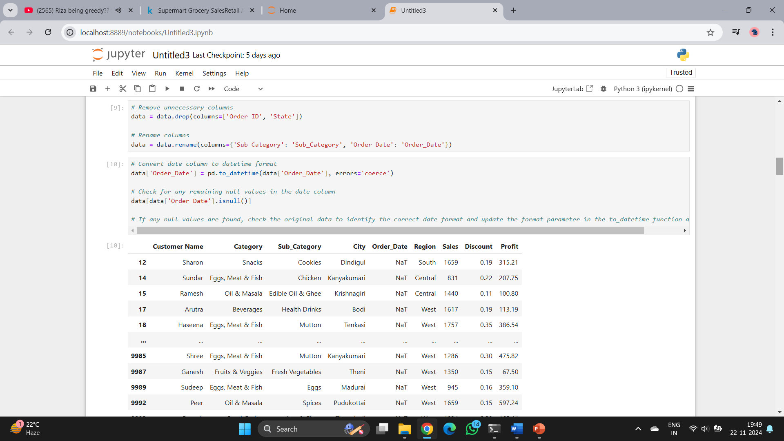
Data Cleaning

Slide 11
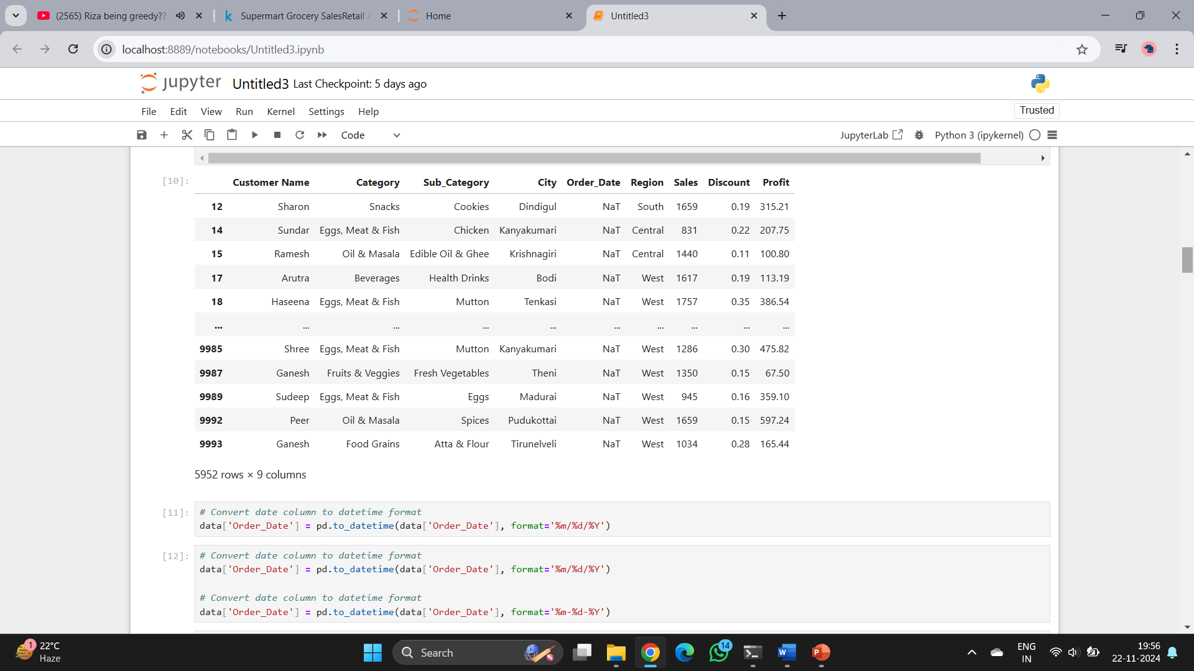

Slide 12
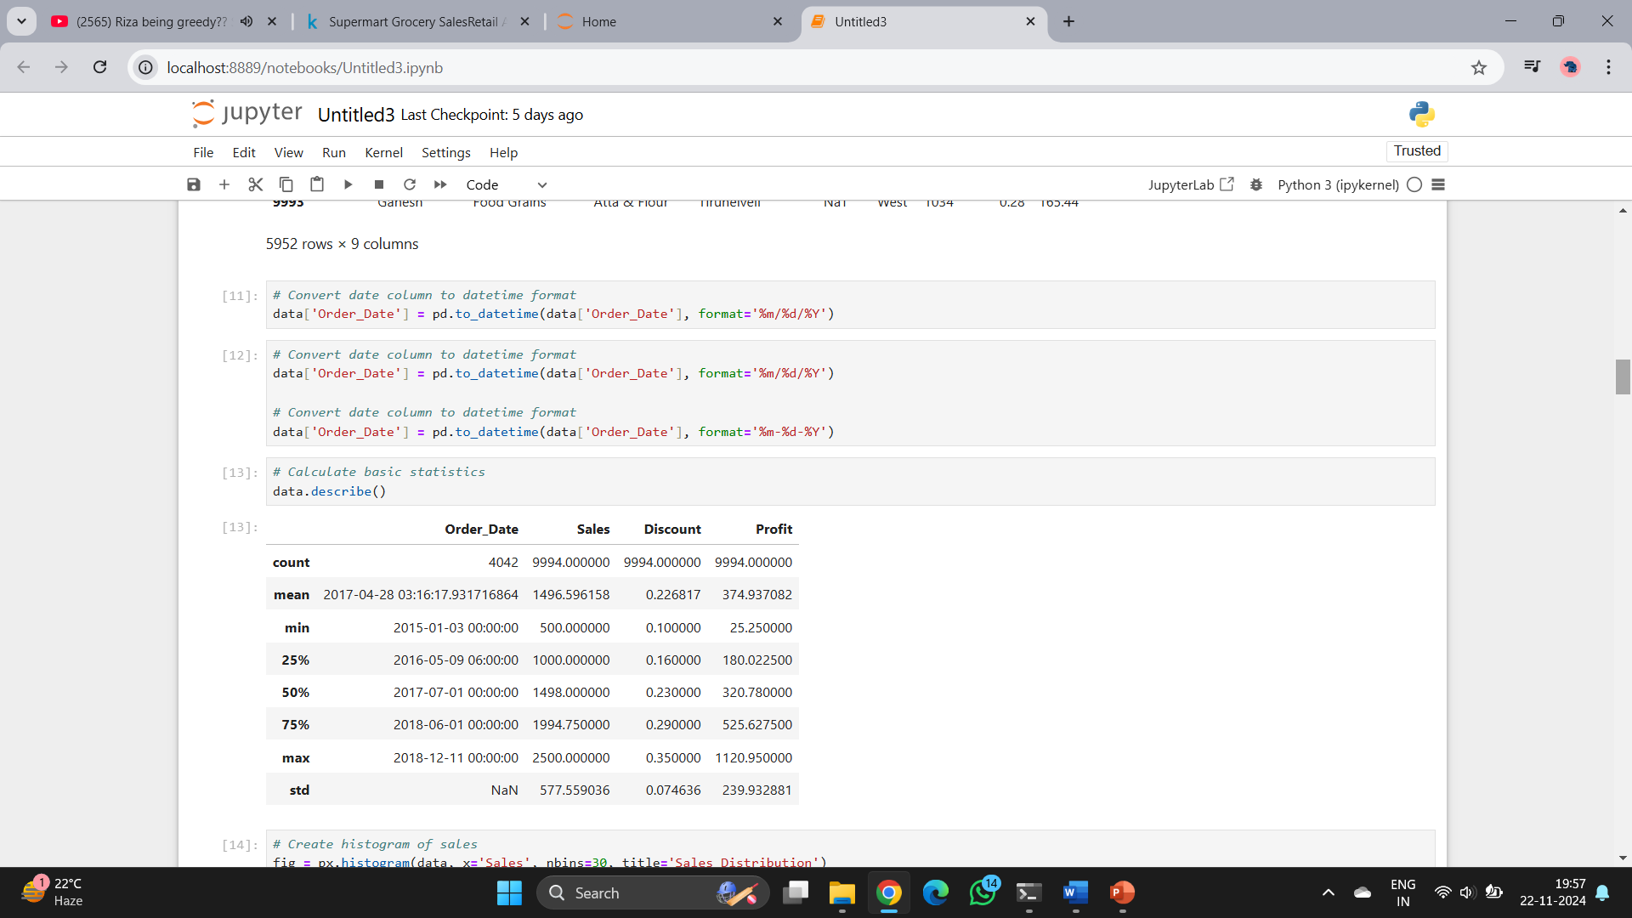

Slide 13
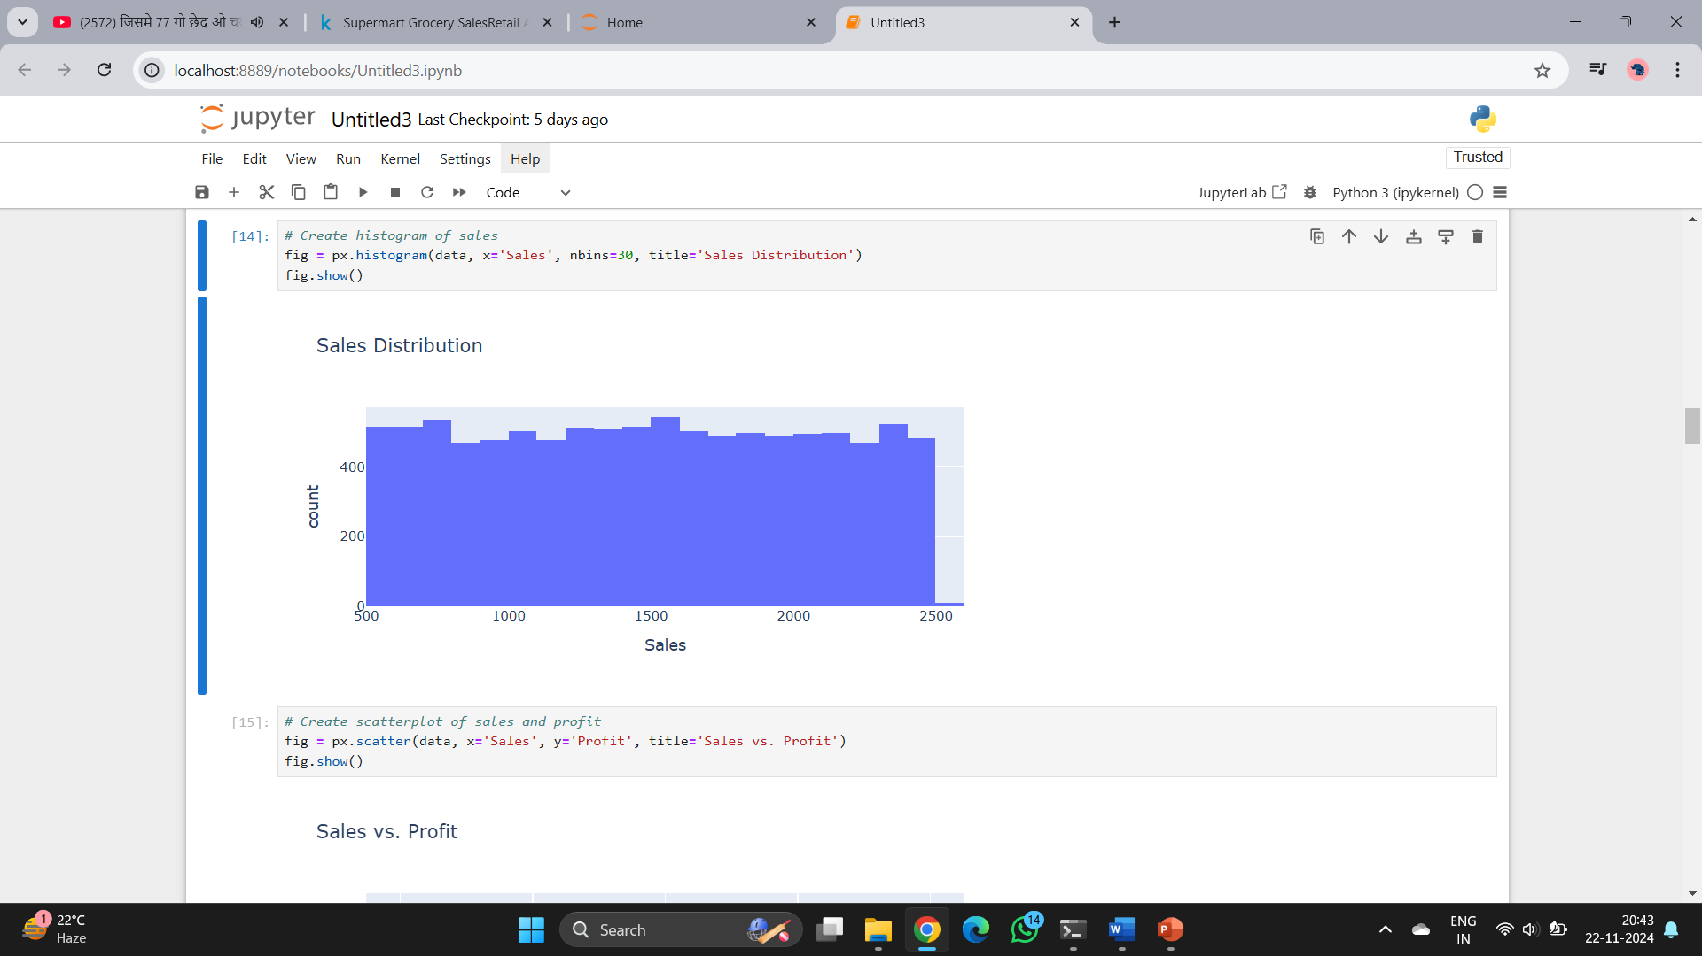
Exploratory data analysis

Slide 14
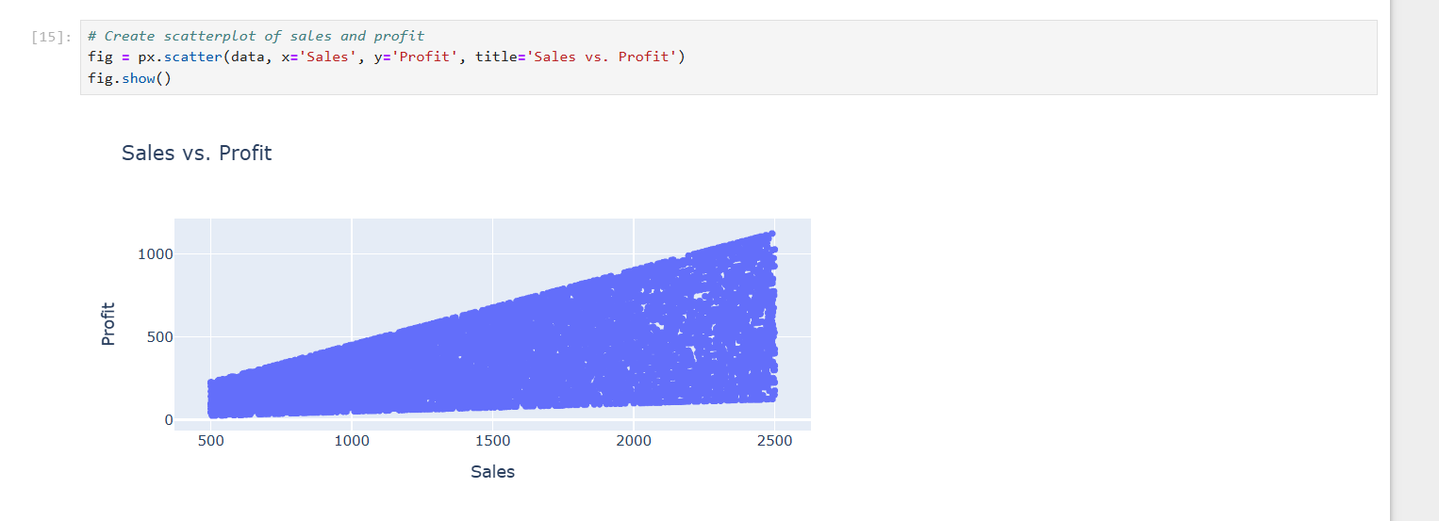

Slide 15
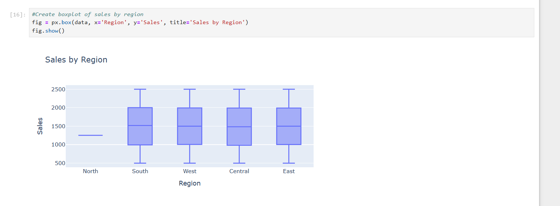

Slide 16
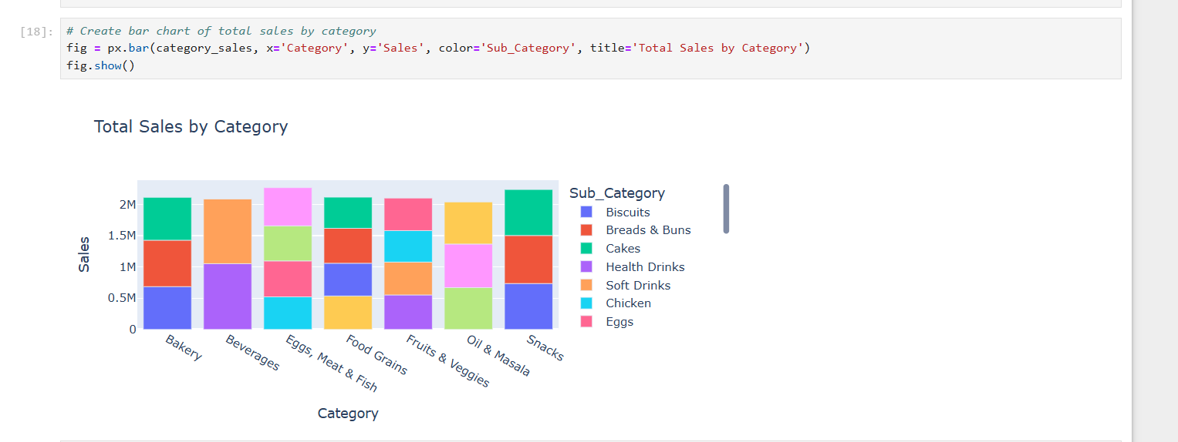
Analyze sales by category and sub-category

Slide 17
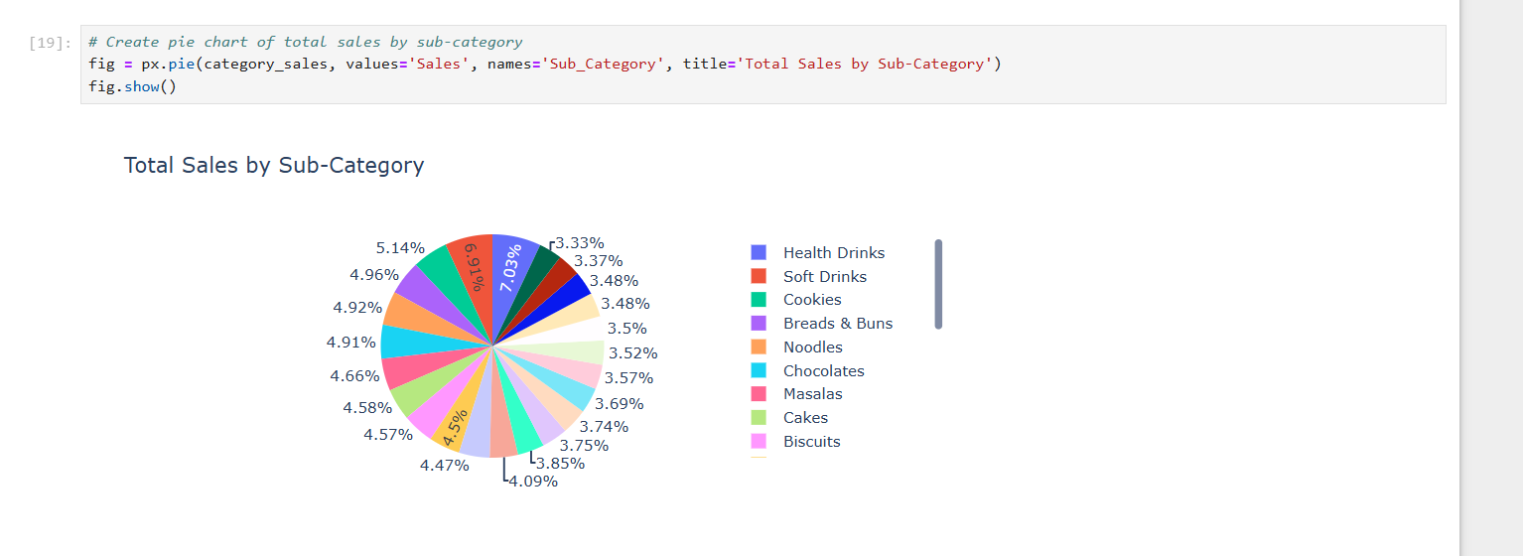

Slide 18
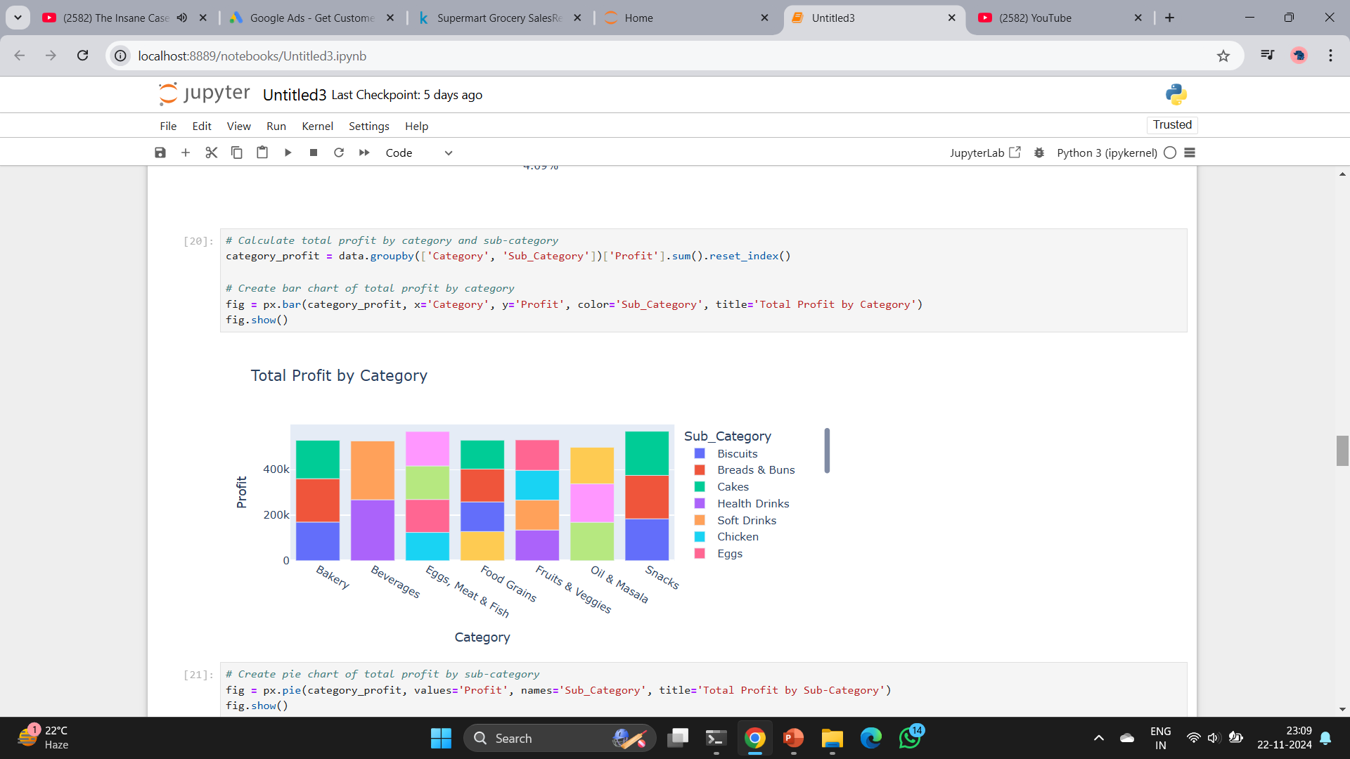
Analyze profit by category and sub-category

Slide 19
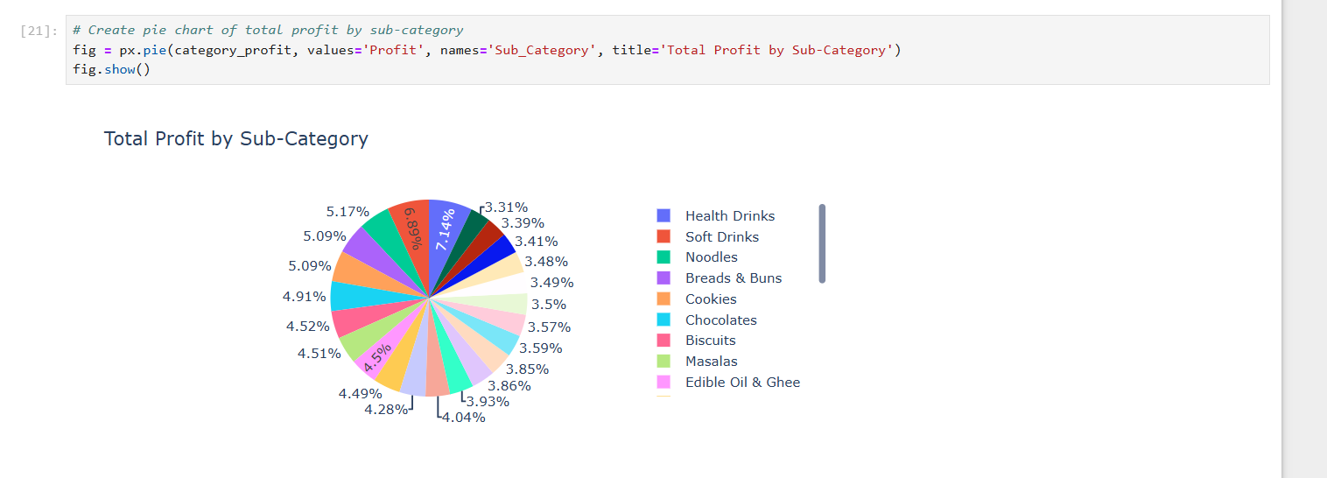

Slide 20
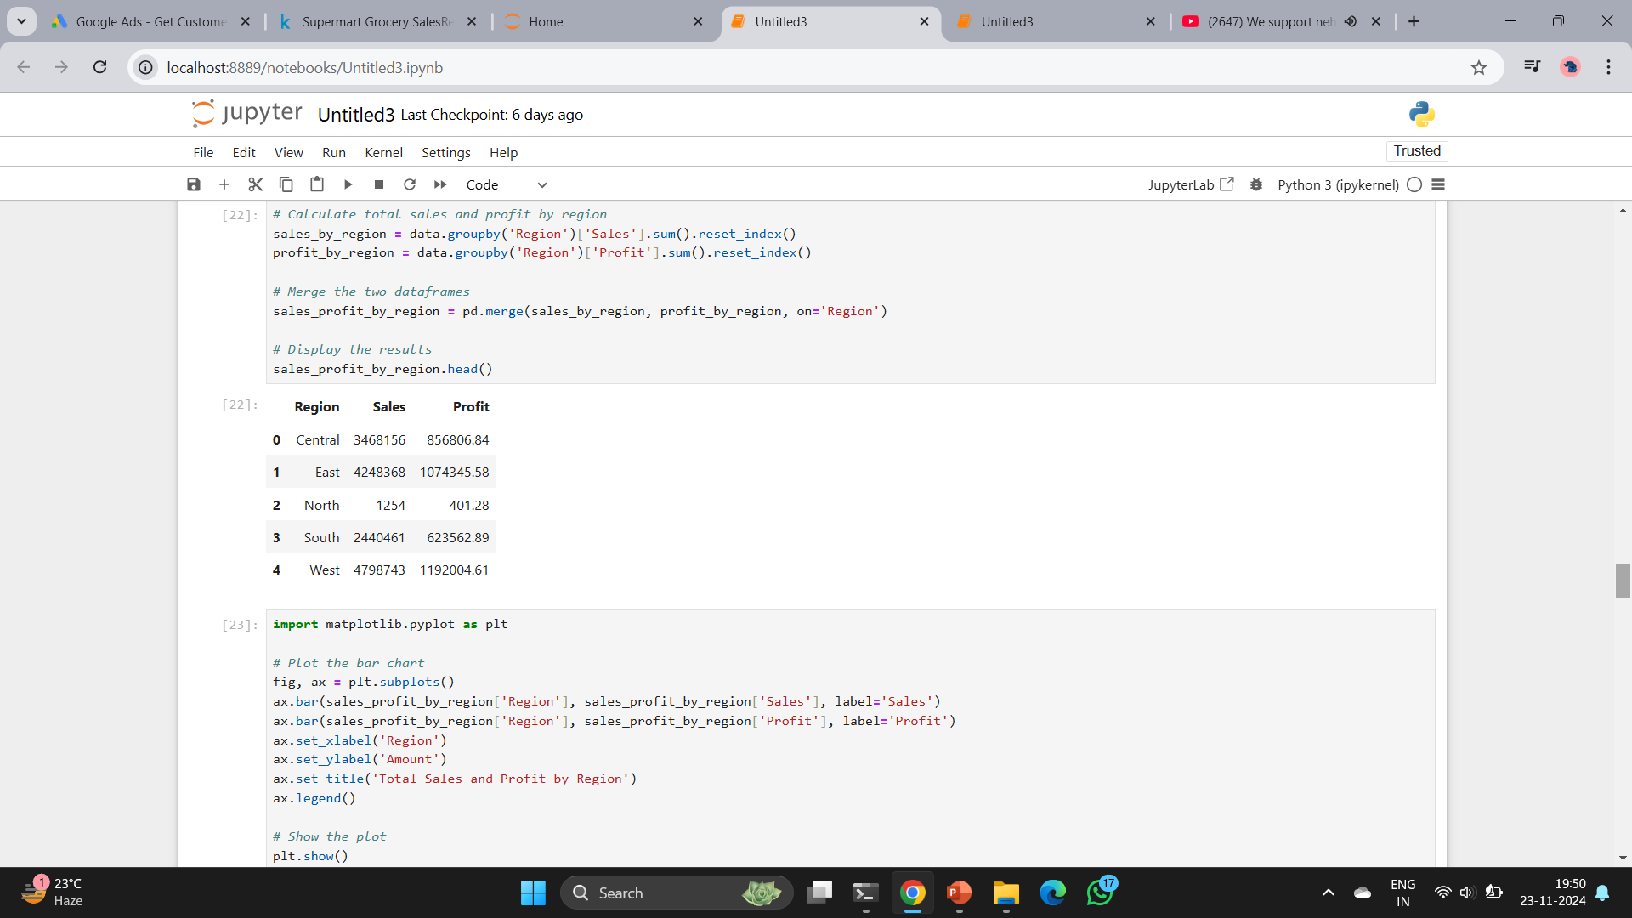
Analyze sales and profit by region

Slide 21
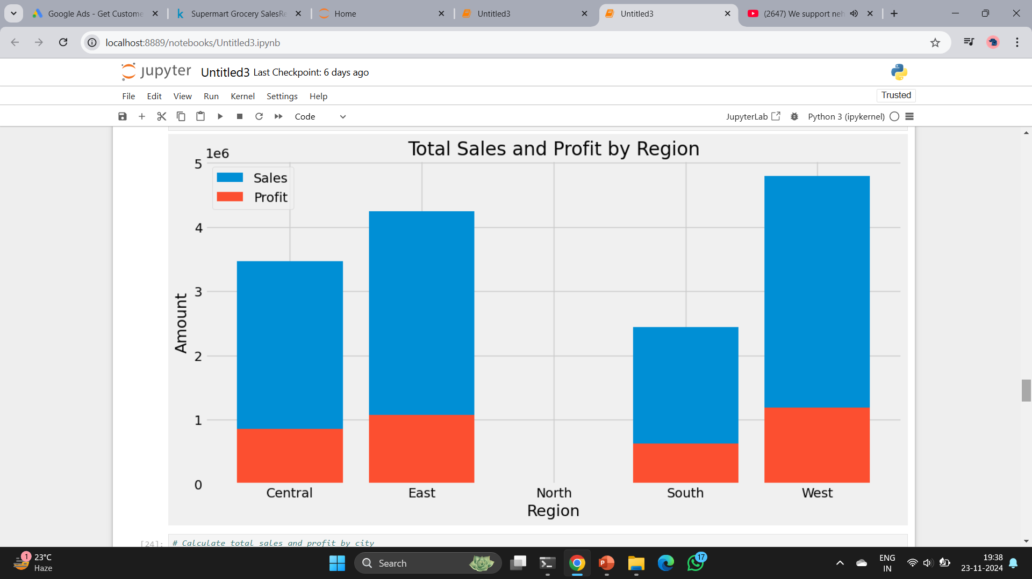
This will give us a bar chart that shows the total sales and profit by region:
We can see that the East and West regions have the highest sales and profit, while the North region has the lowest sales.

Slide 22
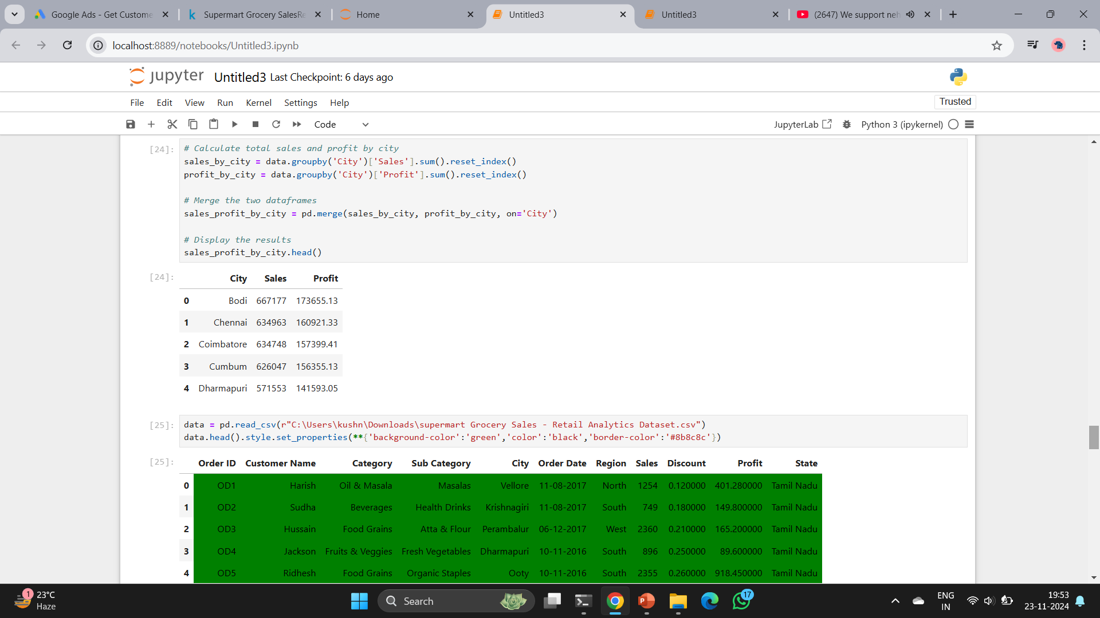
Analyze discounts

Slide 23
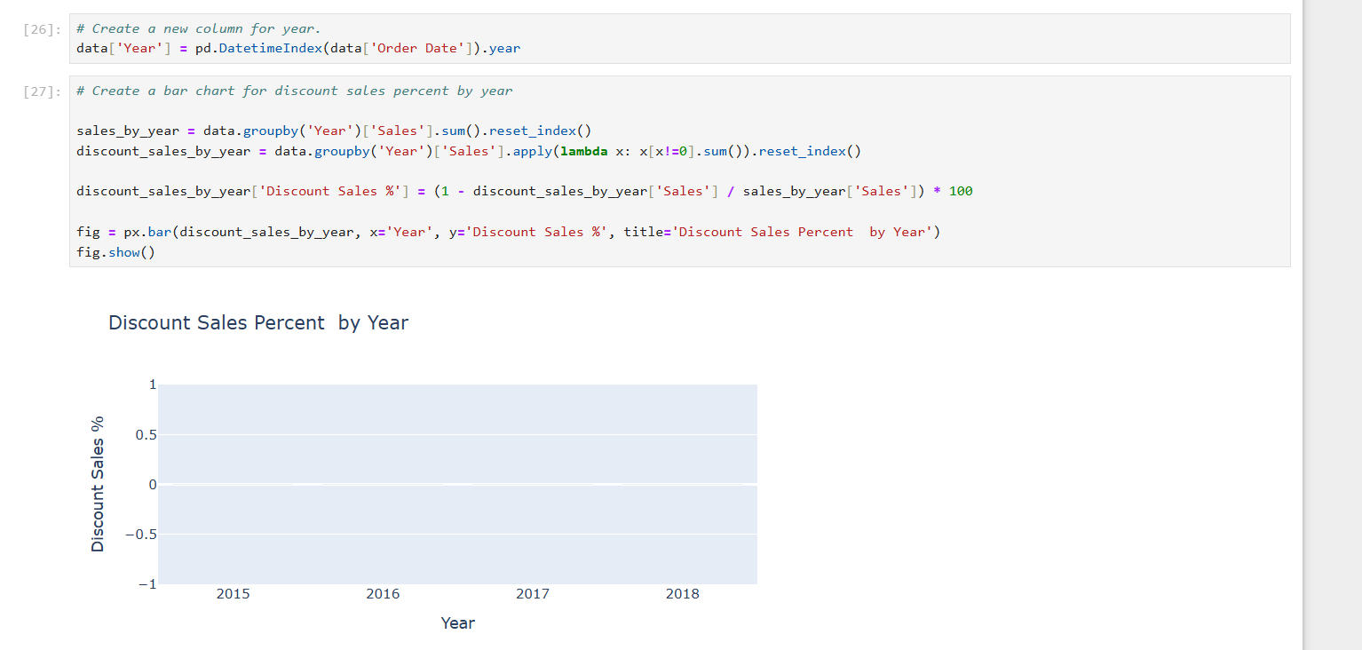
Create a new column for year
Create a bar chart for discount sales percent by year

Slide 24
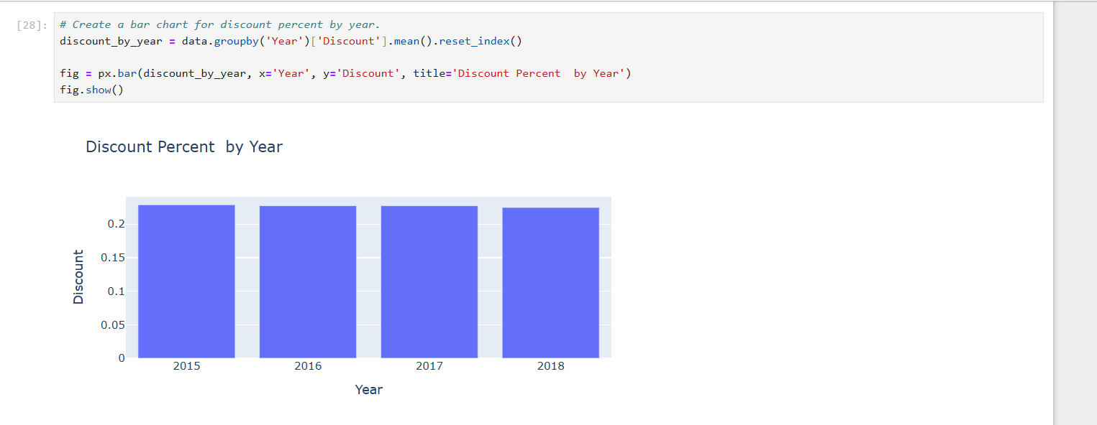

Slide 25
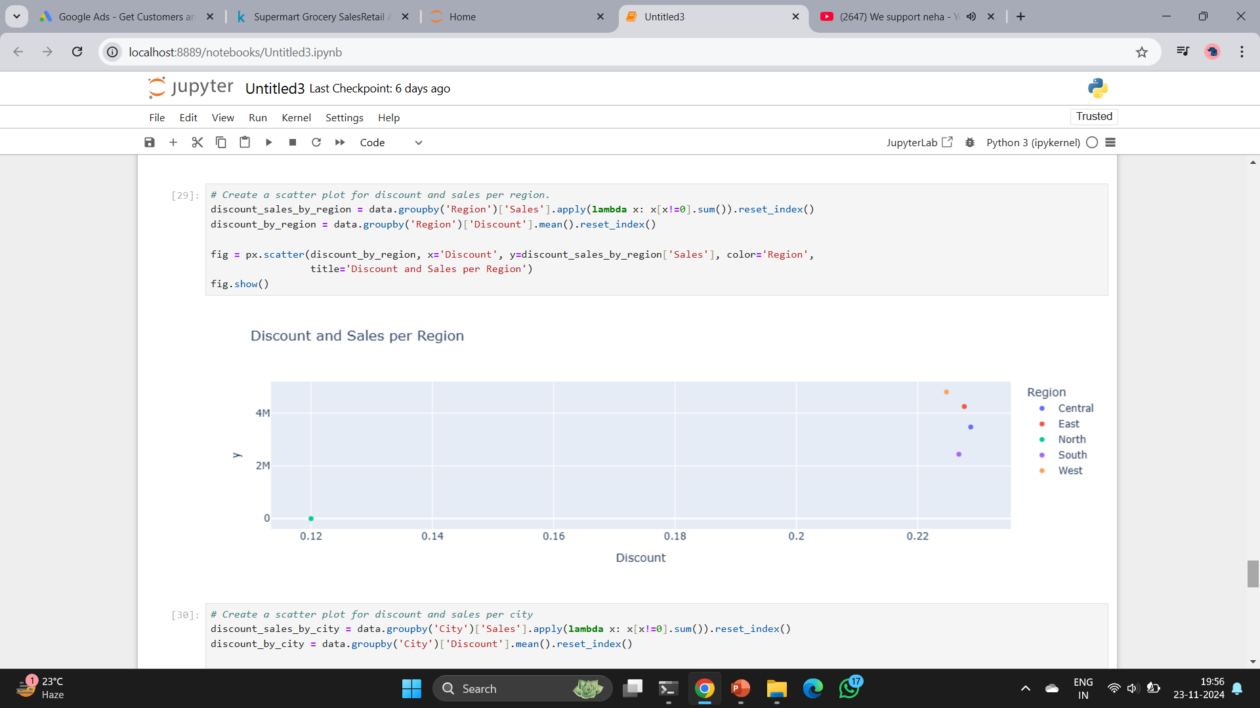

Slide 26
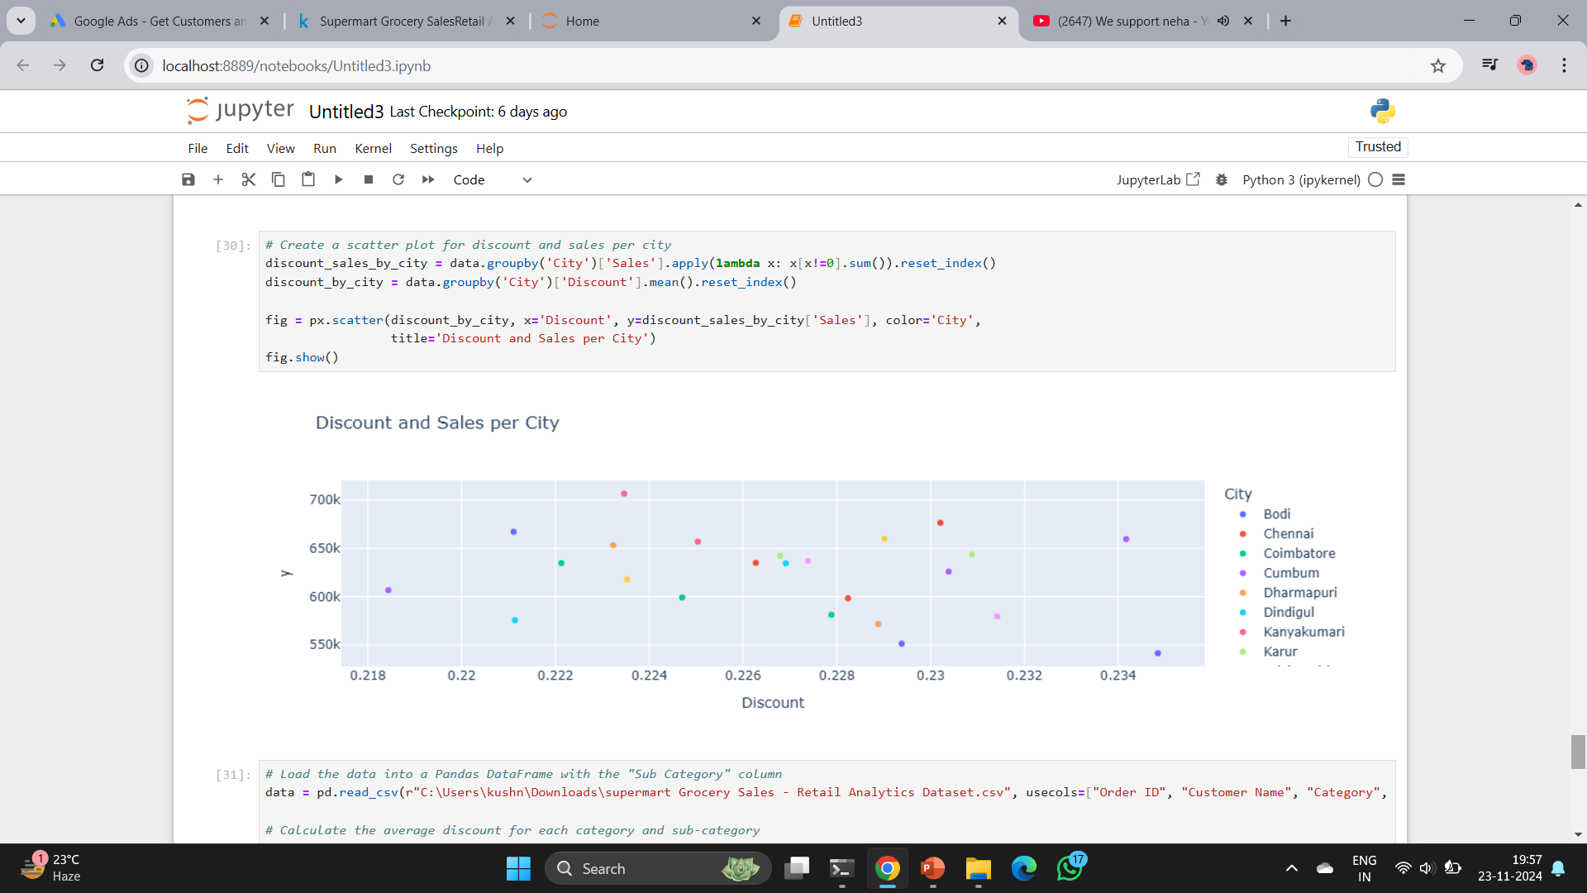

Slide 27
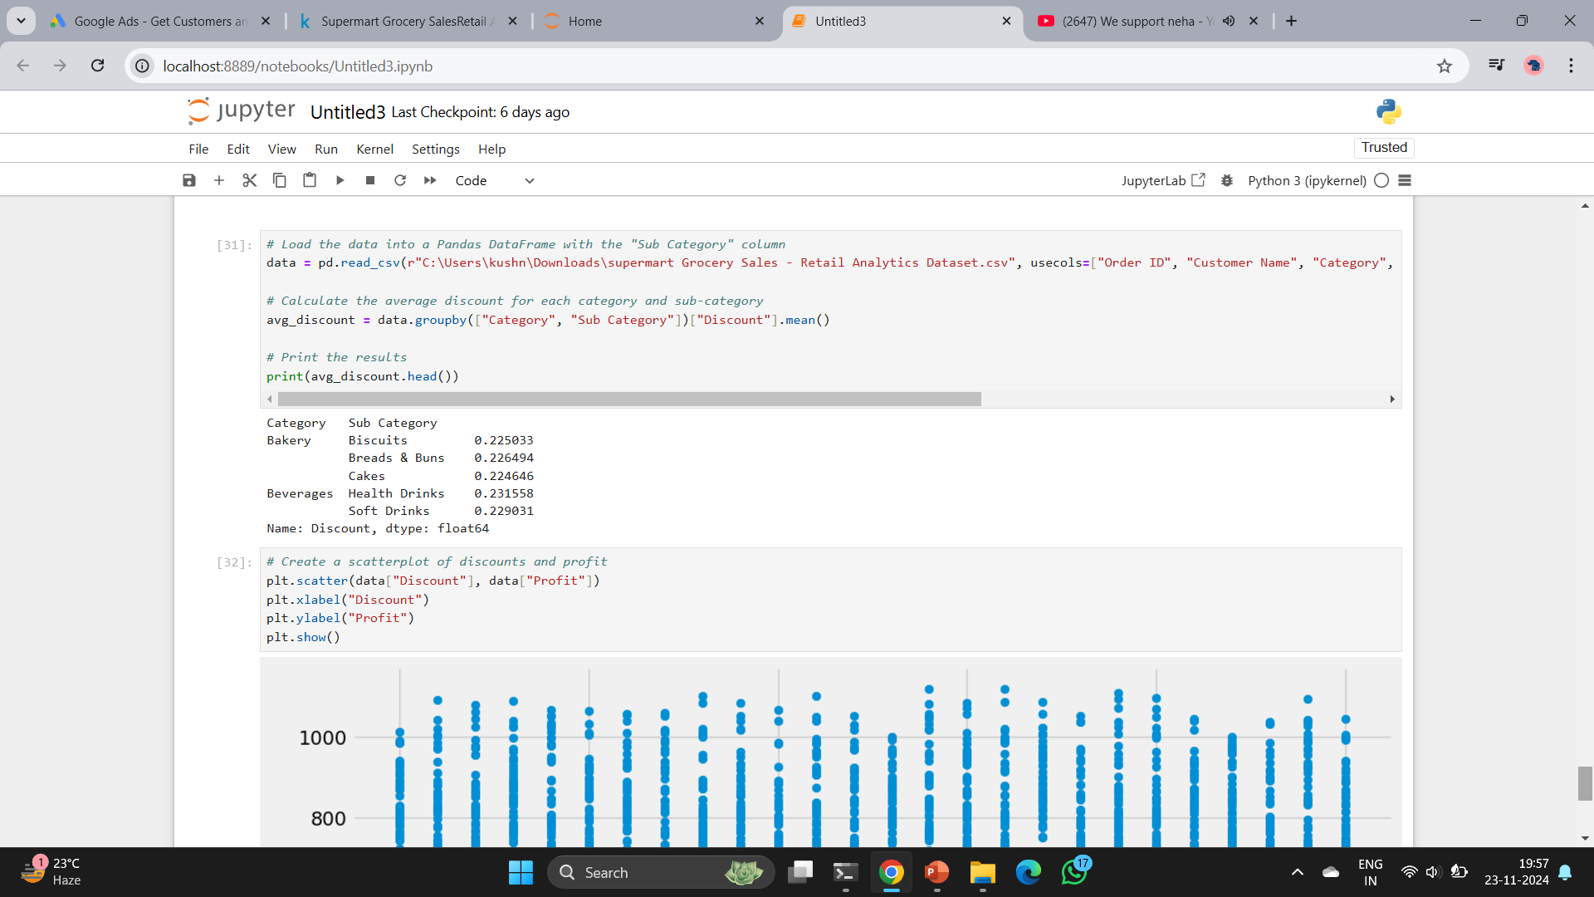
Analyze discounts and their impact on profit

Slide 28
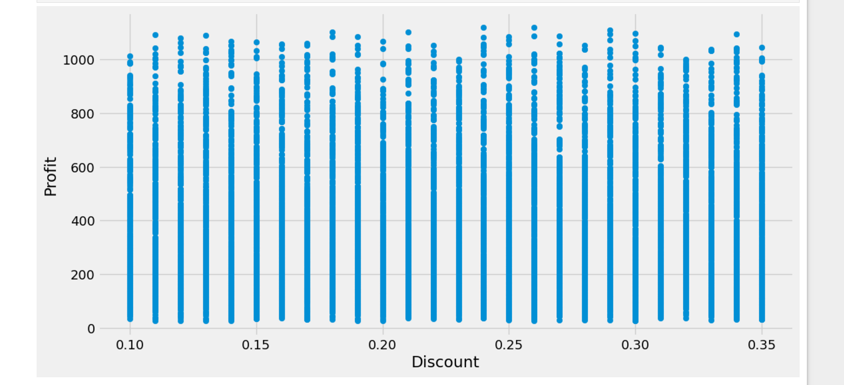

Slide 29
Conclusion
From the results of the analysis, you might find that certain categories or sub-categories have higher sales and profits than others, and that discounts have a negative impact on profit.
Based on these findings, you could recommend reducing the discount amount or changing the discount strategy, and focusing on promoting the products in the categories or sub-categories that are generating the most sales and profits.

Slide 30
THANK YOU

